Slide 1

Lecture #1
Information Security

Slide 2
Course Overview
Name of Course: Information Security
Credit Hours: 3(2-1)
No. of Lectures per week: 2 (Duration 1hr)

Slide 3
Marks Distribution
Internal Assessment: 35 Marks: 10 Quiz, 15 Assignment, 10 Sessional (CCP – Complex Computing Problem)
Mid Semester Examination: 25 Marks
Final Semester Examination: 40 Marks

Slide 4
Rules to Remember
Come to class prepared to learn.
Keep your mobiles Silent and keep it inside your bag.
Late arrival (5 minutes) will be marked Absent
Listen and follow directions.
Actively participate in classroom activities
Ask Questions.
Convey your issue to your instructor through your CR.

Slide 5
Rules for Assignments
No extensions will be granted for submission of assignments.
Once deadline is over, no assignment will be accepted.

Slide 6
Stay safe online! One mistake can cost your privacy.
Passwords, encryption, and firewalls—your digital shield.

Slide 7
What is Security?
Security refers to the protection of systems, data, and resources from threats, attacks, or unauthorized access to ensure safety and reliability.
What is Privacy?
Privacy is the right to control personal information and decide how it is collected, used, and shared to prevent misuse or exposure.
What is Information Security?
Information security (InfoSec) is the practice of protecting data and information systems from unauthorized access, modification, destruction, or disclosure.

Slide 8
Computer security
Computer security means protecting computer systems and data from harm. It ensures that information stays accurate (integrity), available when needed (availability), and private (confidentiality). This includes protecting hardware, software, and communication networks from threats.

Slide 9
Confidentiality:
Confidentiality means keeping information private and only allowing authorized people to access it. It has two parts:
Data confidentiality – Ensures that sensitive information is not shared with unauthorized people.
Privacy – Gives individuals control over their personal information, deciding who can collect, store, and share it.

Slide 10
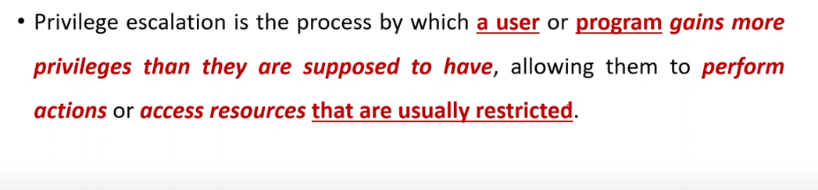
Privilege Escalation

Slide 11
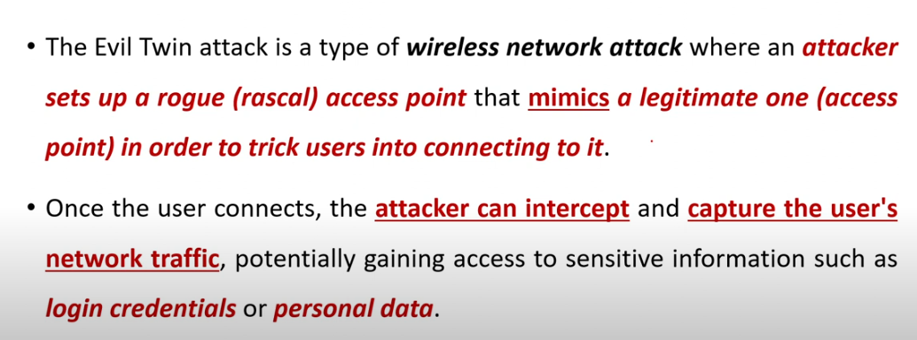
Evil Twin

Slide 12
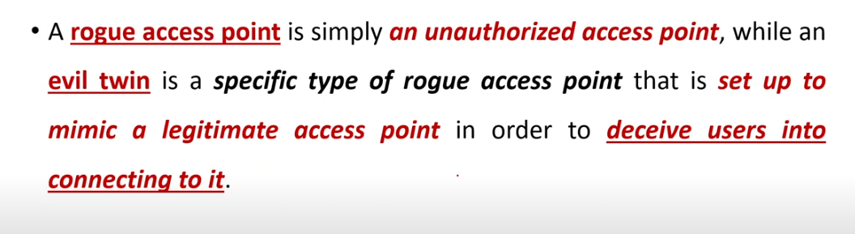
Rogue Access Point

Slide 13
Integrity:
Integrity ensures that information and systems remain accurate and trustworthy. It has two parts:
Data integrity – Ensures that information is changed only in a correct and authorized way.
System integrity – Ensures that a system works properly without being damaged or manipulated.

Slide 14
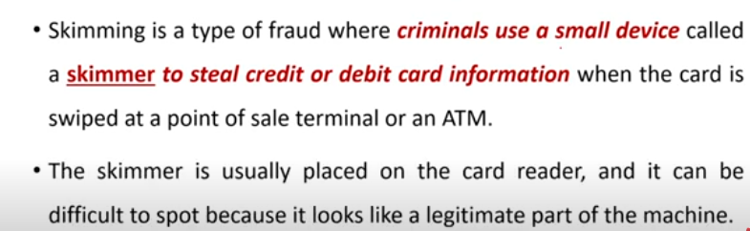
Skimming

Slide 15
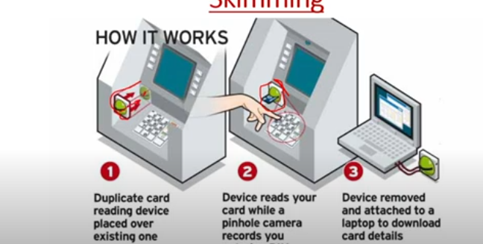
Skimming

Slide 16
Availability:
Availability means that systems and services work when needed, ensuring authorized users are not blocked from access.

Slide 17
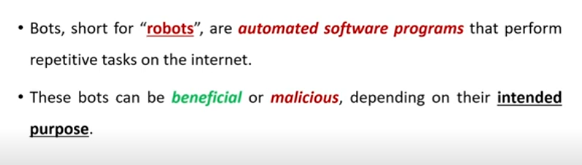
BOTS

Slide 18
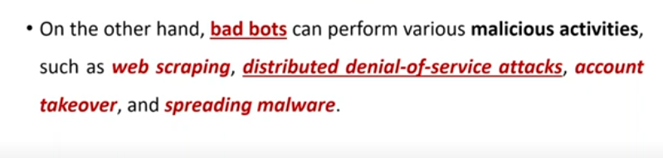
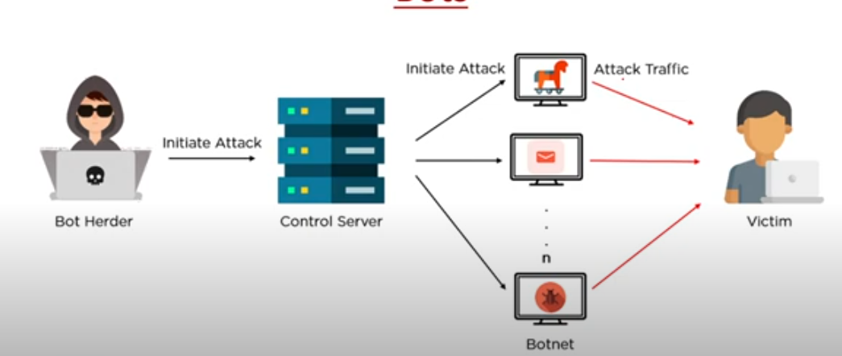

Slide 19
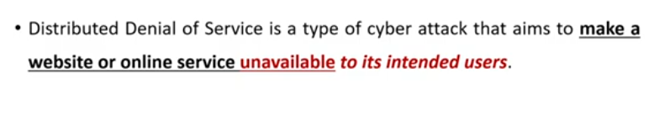
DDOS

Slide 20
FIPS 199 Security Objectives (CIA Triad):
Confidentiality – Ensures that sensitive information is accessible only to authorized individuals. Unauthorized access or disclosure results in a loss of confidentiality.
Integrity – Protects information from being altered or destroyed in an unauthorized way. This also includes ensuring authenticity and preventing data tampering. A loss of integrity means the data has been modified, deleted, or corrupted.
Availability – Ensures that information and systems are accessible when needed by authorized users. A loss of availability means that users cannot access the system due to disruptions or attacks.
Notes:
Federal Information Processing Standard Publication 199

Slide 21
Additional Security Concepts:
Authenticity – Ensures that data, messages, and users are genuine and can be verified. This prevents impersonation and fraud.
Accountability – Ensures that actions within a system can be traced to the responsible person. This helps in tracking security breaches, preventing fraud, and supporting legal investigations.
These principles form the foundation of information security, ensuring systems remain safe, trustworthy, and reliable.

Slide 22
Pillar | What it Protects | Attacks that break it
Confidentiality | Who can see data | Privilege Escalation, Evil Twin, Rogue Access Point
Integrity | Whether data can be trusted | Skimming (card cloning/fraud)
Availability | Whether you can use it | Bots→ Botnet → DDoS

